Slide 1


Password manager Using GUI App with Tkinter Presentation by JEGEDE OLUWAFOLABOMI

Slide 2
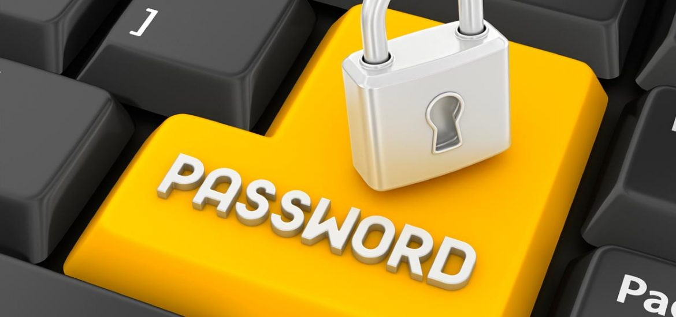
What does Password mean ? A password, sometimes called a passcode is a secret data, typically a string of characters, usually used to confirm a user's identity. Traditionally, passwords were expected to be memorized ,but the large number of password-protected services that a typical individual accesses can make memorization of unique passwords for each service impractical.
This Photo by Unknown Author is licensed under CC BY

Slide 3
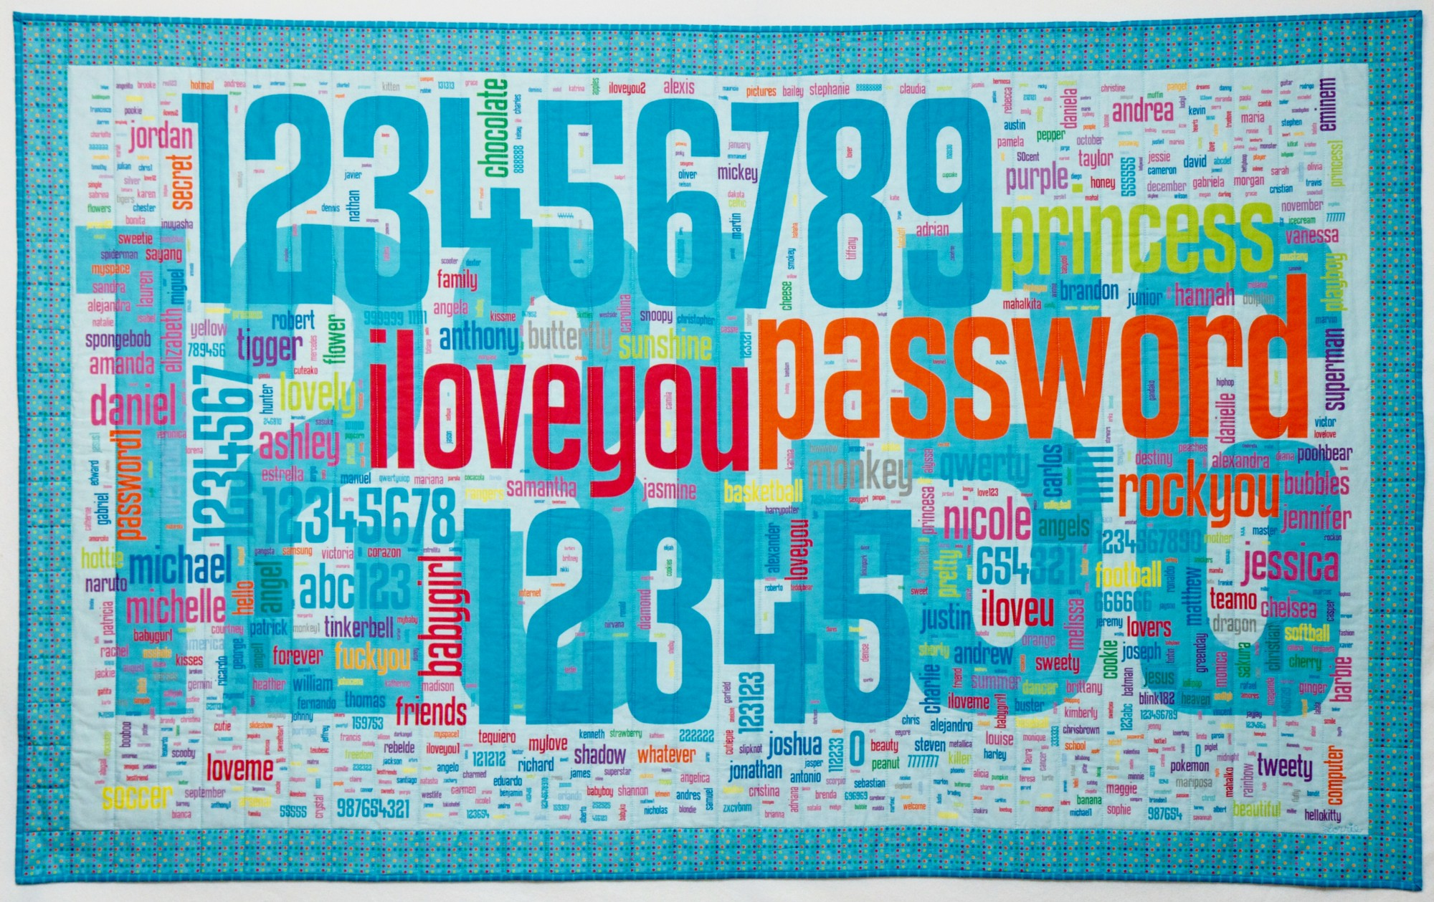
Reasons we need password manager app for our passwords ?
8
1. Your passwords are too simple.
This is the biggest reason, bar none. If you’re using passwords that you can easily remember (such as password, password123, happyhappyjoyjoy, etc.) you’re at risk. Why? Simple passwords are easier to crack. With the right tools (and enough horsepower) a hacker can crack those simple passwords in seconds or minutes. Because of this, you want to make sure that the passwords you use are hard (if not impossible) to remember. A good rule of thumb is that if you can easily remember a password, it’s probably easy to crack. The harder that password is to remember, the harder it is to crack. So when you use such difficult passwords, you need a vault to house them. That’s where the password manager comes into play.
This Photo by Unknown Author is licensed under CC BY

Slide 4
2. Password Managers Suggest Strong Passwords
If you have no idea how to create strong passwords, you should use a password manager. Password managers can generate secure and complex passwords for all your accounts with just one click of a button.
And as we mentioned, you don’t have to remember any of them because the software will do the job for you. You just have to remember one master password, which will unlock the software so you can visit your secure websites, where they also offer two-factor authentication.
User Interface Design
The actual design of the interface of the digital product

Slide 5
3. You Can Sync Your Passwords Across Multiple Devices
Another great benefit of using a password manager is that you can sync your passwords across multiple devices. This means that if you have a laptop and a desktop, or an iPhone and an Android phone, your passwords will be available on both devices.
This is handy if you tend to use different devices for different purposes. For example, you might use your laptop at work and your phone on the weekends. With a password manager, you can have the same passwords available on both devices without remembering multiple passwords.

Slide 6
4. You Can Store Sensitive Information Safely
You should also consider using a password manager because it’s a great way to store sensitive information. If you have ever tried storing passwords on an Excel spreadsheet, for example, the chances are that your information wasn’t as secure as it could be.
Password managers solve this problem by encrypting data and requiring multiple security steps before allowing access to stored data. This means that even if someone manages to hack into your password manager, they won’t be able to access your sensitive information without the proper credentials.
This is crucial not only for personal accounts but also for business accounts. In fact, many businesses are now requiring employees to use a password manager to store work-related passwords

Slide 7
5. No More Fumbling with Login Screens
With a password manager, you also enjoy fast access. Once you’ve created and stored your passwords in your password manager, you’ll be able to access them quickly and easily.
Every time you log onto a site or app, you’ll be prompted to enter your master password. Once you’ve entered it, the password manager will automatically fill in all your other accounts’ login information.
This means that you won’t have to fumble with different login screens or remember multiple passwords.

Slide 8
6
You Can Store More than Passwords
Another great thing about password managers is that they don’t only store passwords. Many password managers can store other information securely, including bank account details, credit card numbers and software licenses.
This is particularly useful if you have to frequently access accounts that ask for the same information repeatedly.
For example, when you download a program from Adobe or Microsoft Office website, you’ll be asked to enter your name, address and other contact information.
With a password manager, you can store this data in one place so that you don’t have to type it in every time. This also means that if someone gains access to your accounts, they won’t be able to steal your identity or worse.

Slide 9
7
It’s Easier to Manage Shared Accounts
Managing how many people have access to a single account can be a complete nightmare for businesses.
One of the most critical benefits of a password manager is its ease of use. Businesses can store account information in one place, so everyone has access whenever they need it, making it incredibly difficult for someone to get into an account without permission.
Some password managers also have a feature that allows the account owner to create a password and share it with the rest without them knowing what the password is. Consequently, you can rest assured that your information is secure even when you’ve stopped working with the person because all you have to do is change the password and share it with the rest again.

Slide 10
8
Ensure You’re Not Locked Out of Important Information
Picture a scenario where only one person can provide login details for all employees, and they aren’t accessible. In such a situation, the employees will be locked out of important information that they need to carry on with their work.
Fortunately, this is a problem a password manager can solve. With this handy tool, you can designate a password administrator who can give login details to other employees when they need it. This way, you’re not locked out of important information even when you’ve stopped working with the person who initially had access to it.
Wrapping Up
As you can see, a password manager is a valuable tool that helps solve numerous issues. It makes the password management process easy for businesses, and it helps prevent security breaches, which can cause irreparable damage to your business’s reputation.
If you’re in charge of managing passwords or are looking into protecting your data, it’s time to look into a password manager.

Slide 11
Python offers multiple options for developing GUI (Graphical User Interface). Out of all the GUI methods, tkinter is the most commonly used method. It is a standard Python interface to the Tk GUI toolkit shipped with Python. Python with tkinter is the fastest and easiest way to create the GUI applications. Creating a GUI using tkinter is an easy task. To create a tkinter app:
Importing the module – tkinter
Create the main window (container)
Add any number of widgets to the main window
Apply the event Trigger on the widgets.
Importing tkinter is same as importing any other module in the Python code. Note that the name of the module in Python 2.x is ‘Tkinter’ and in Python 3.x it is ‘tkinter’.
import tkinter
:
WORKING
WI
T
H
T
K
I
N
T
E
R

Slide 12
THANK
YOU

Slide 13
Product Design Presentation by JEGEDE OLUWAFOLABOMI

